Slide 1
www.makeithappen.club

Slide 2
Inspiring ideas

Slide 3
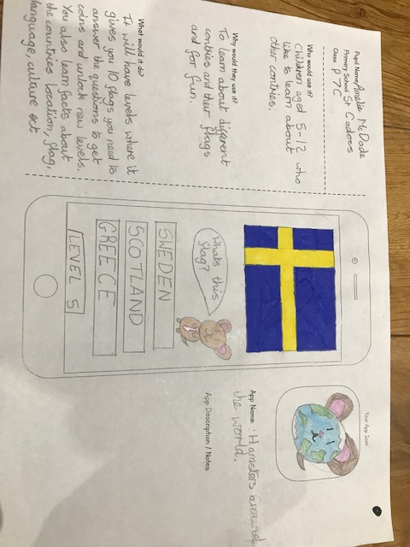
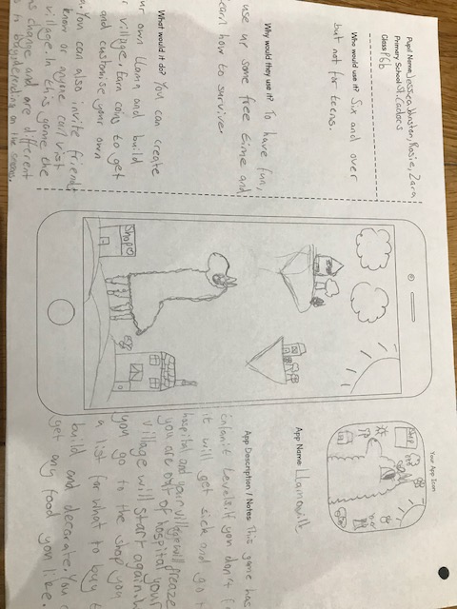
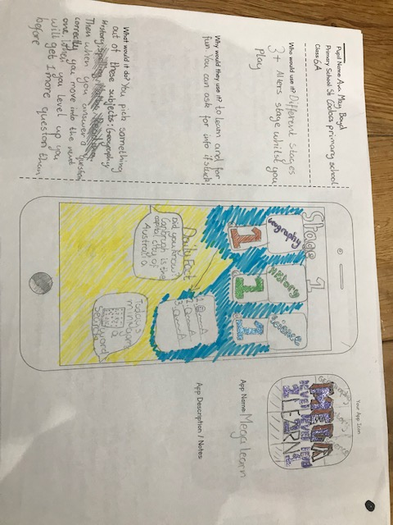
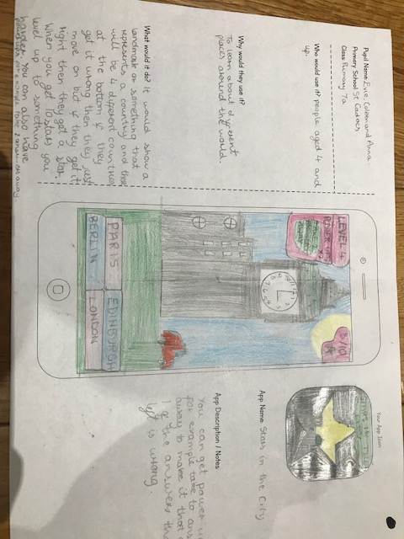
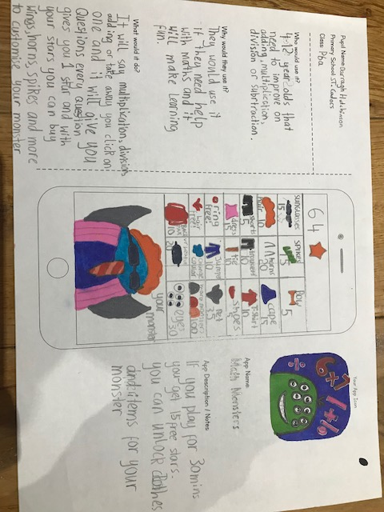
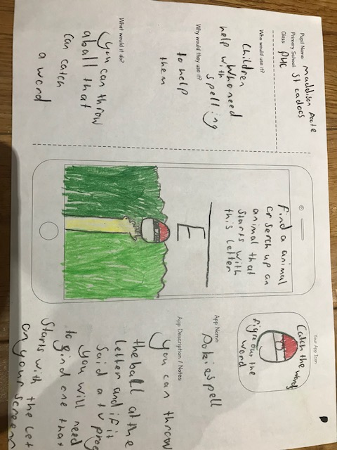
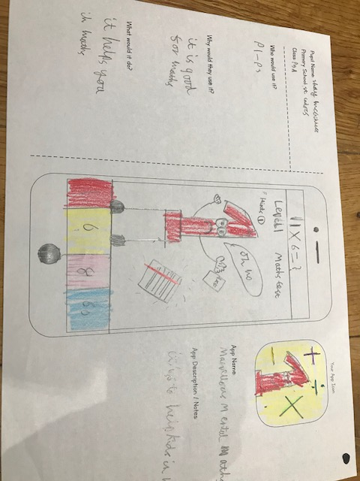
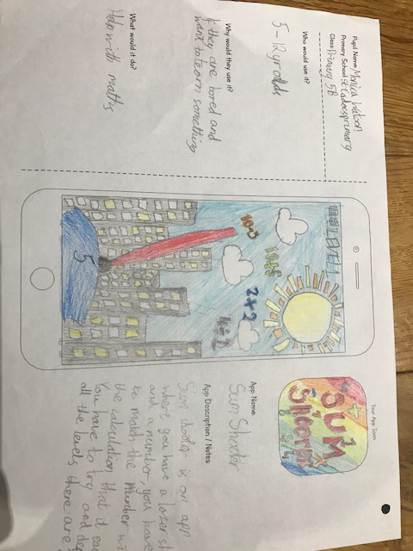
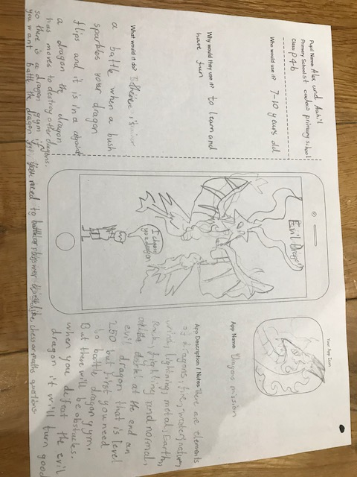
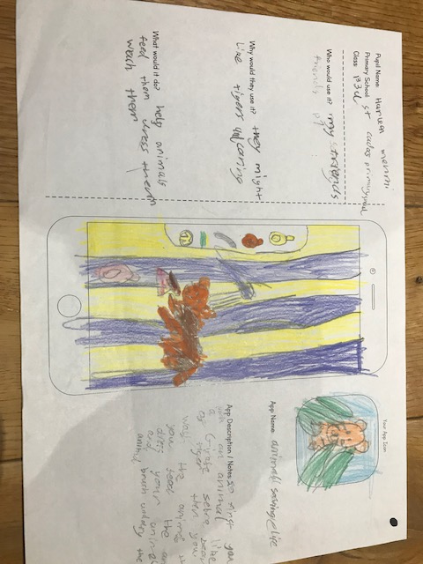
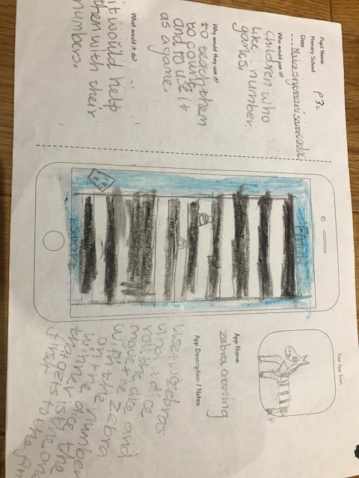
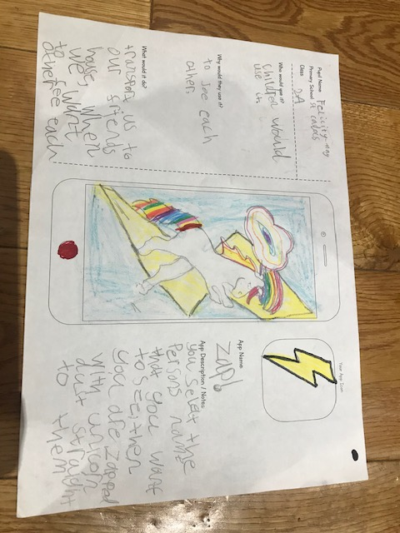
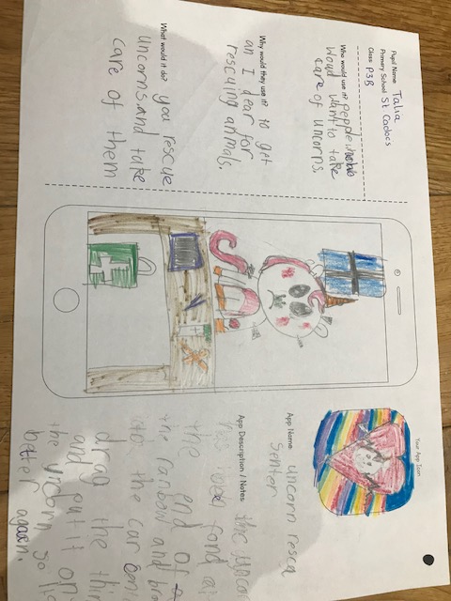

Slide 4

Runners up - 1

Slide 5
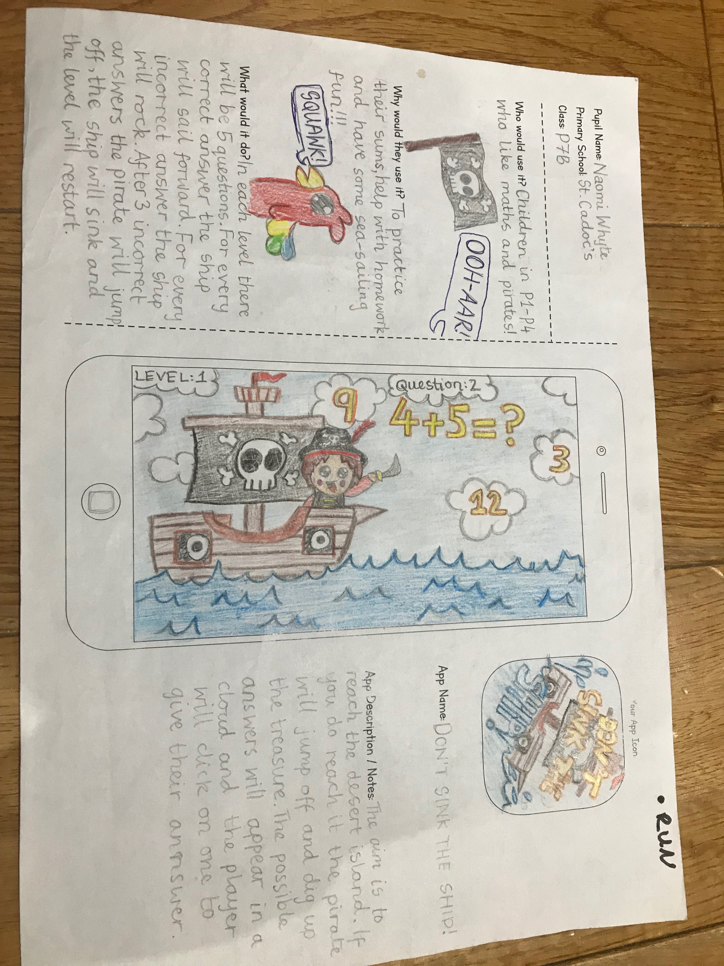
Runner up – Naomi Whyte P7b
Don’t Sink the Ship!
Picture of entry

Slide 6
Runners up - 2

Slide 7
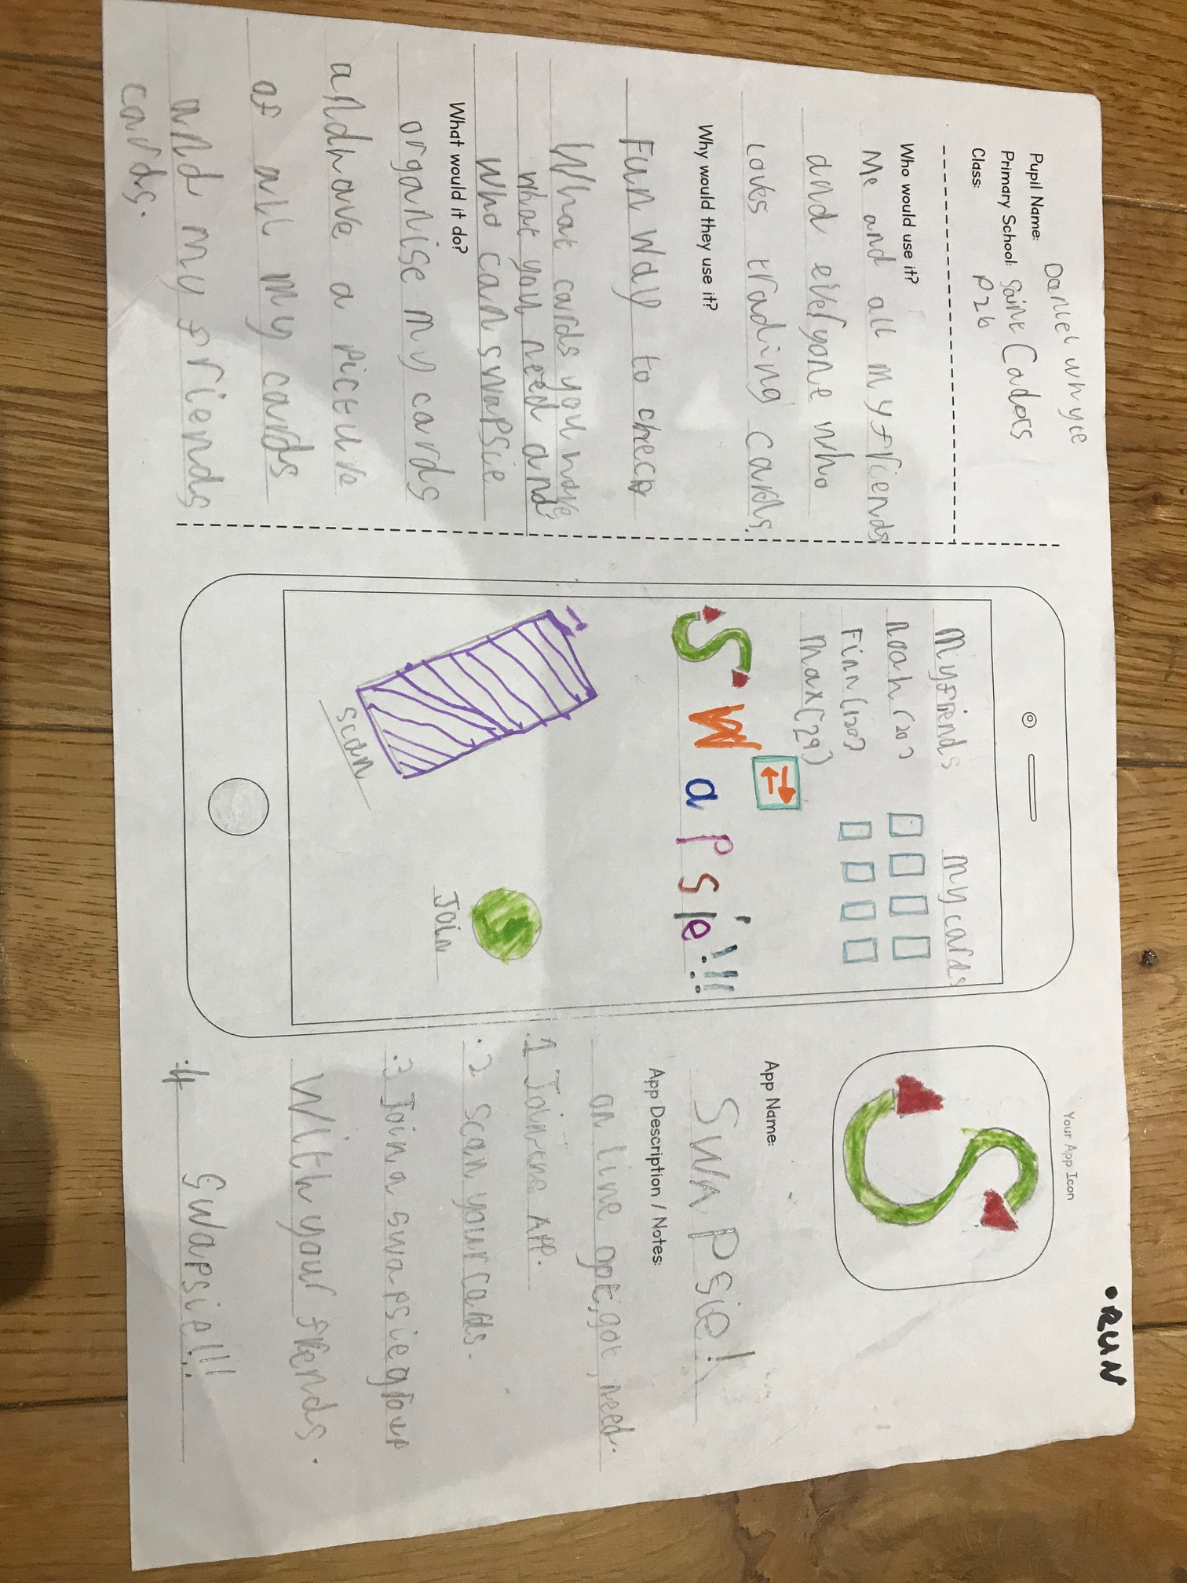
Runners up – Daniel Whyte P2b
Swapsie!
Picture of entry

Slide 8
Winner

Slide 9
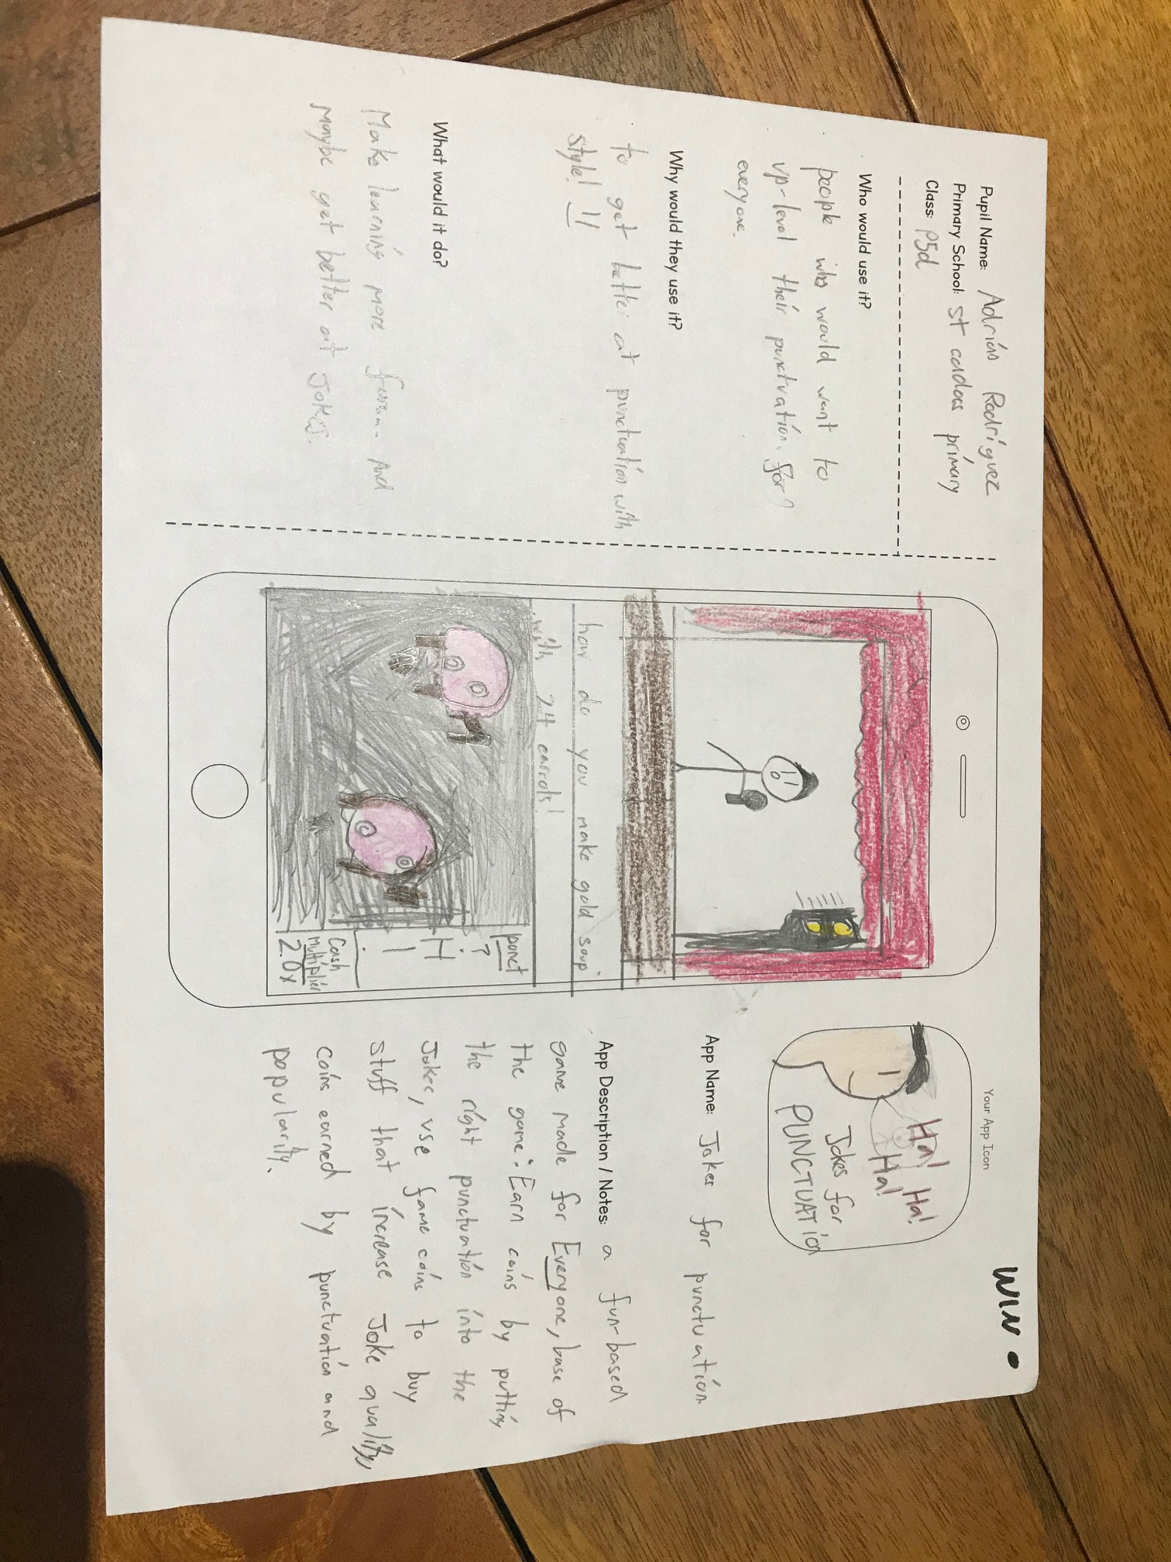

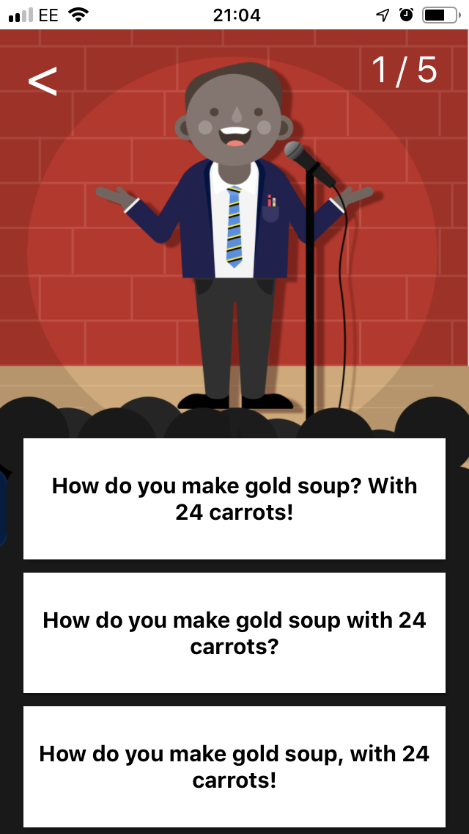

Winner – Adrian Rodriguez P5d
Jokes for Punctuation
Picture of entry

Slide 10
What’s next…
Finish the winning app idea today
Download and play the winning app
“Jokes for Punctuation”
You can take all your ideas forward – thunkable.com
Visit www.makeithappen.club

